Slide 1
Loan Applications Machine Learning
Kavish, Chang and Damian

Slide 2
Introduction
The aim of this project is to use machine learning to predict whether an individual will become bankrupt based on their financial history.
Machine learning can be used as a tool for credit loan assessments, providing efficient and accurate way to evaluate the creditworthiness of loan applicants.

Slide 3
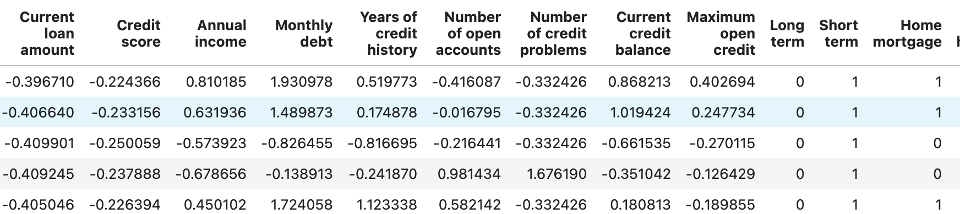
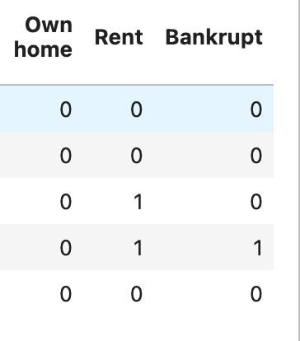
Background
Dataset: https://www.kaggle.com/datasets/zaurbegiev/my-dataset
Variables in the dataset: Loan ID, Customer ID, Current loan amount, Term, Credit Score, Annual income, Current years in job, Home Ownership, Purpose, Monthly dept

Slide 5
Data Cleaning
Unwanted values were dropped based on research, this included null values within the dataset.
The following data was dropped during the data cleaning process: Loan ID, Customer ID, Years in current job, Loan status, Tax liens and purpose.
Dataset was standardized in order to preform machine learning

Slide 6
Models
Random Forest
Neural Networks
Ensemble

Slide 7
Random Forest
Random Forest is an ensemble learning method commonly used for classification, regression, and other machine learning tasks. It belongs to the family of tree-based models and is known for its high accuracy, robustness, and versatility.
Optimization: The model was optimized by altering the number of trees, tree depth and feature importance.

Slide 8
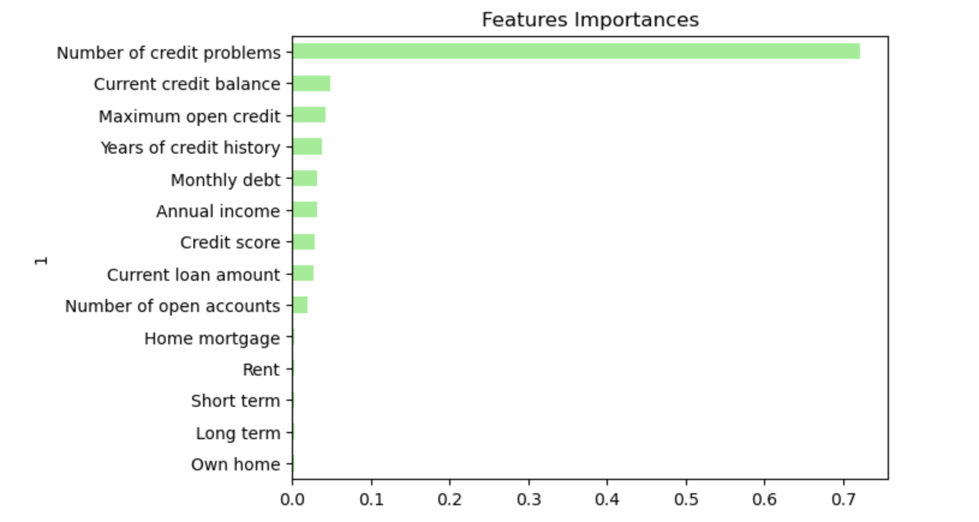
Random Forest

Slide 9
Neural Networks

Slide 10
Ensemble

Slide 11
User interface

